Slide 1
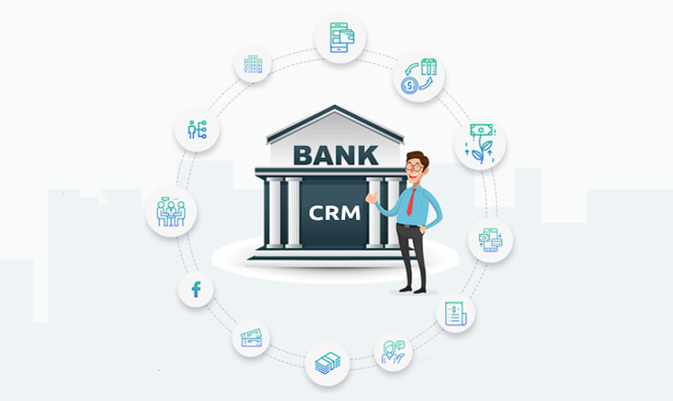
ANALYTICAL CRM DEVELOPMENT FOR – BANK CHURN ANALYSIS
-BY ROHIT DESHPANDE

Slide 2

Bank CRM Overview
This capstone project delves into Bank Customer Relationship Management (CRM). CRM empowers banks to build stronger relationships through data analysis.
Our CRM system serves as a strategic tool for fostering stronger connections with our customers. Its centralized customer data, enabling personalized interactions, targeted marketing, and effective issue resolution.
Through segmentation and analytics, we identify customer needs, preferences, and behaviors, empowering us to tailor offerings and experiences. With a focus on retention and satisfaction, our CRM drives loyalty, revenue growth, and operational efficiency.
Let’s explore the transformative power of CRM in banking.

Slide 3

Problem Statement
You are an analytical CRM (Customer Relationship Management) specialist hired by a bank to extract meaningful insights from various customer-related datasets.
The bank aims to reduce customer churn, improve service delivery, and enhance customer satisfaction.
They have provided you with datasets including customer demographics, transaction details, customer exit information, and active customer profiles.

Slide 4

Process Cycle
Data Consolidation and Preprocessing
Transformation of data using Excel & PowerBI
Data Analysis and Visualization
SQL Queries output, and visuals & dashboarding in PowerBI
Data Storage and Manipulation
Import processed Excel data into SQL & write Queries
Objectives and Documentation
Determining Insights, Issues, Strategies of churn & documenting it

Slide 5
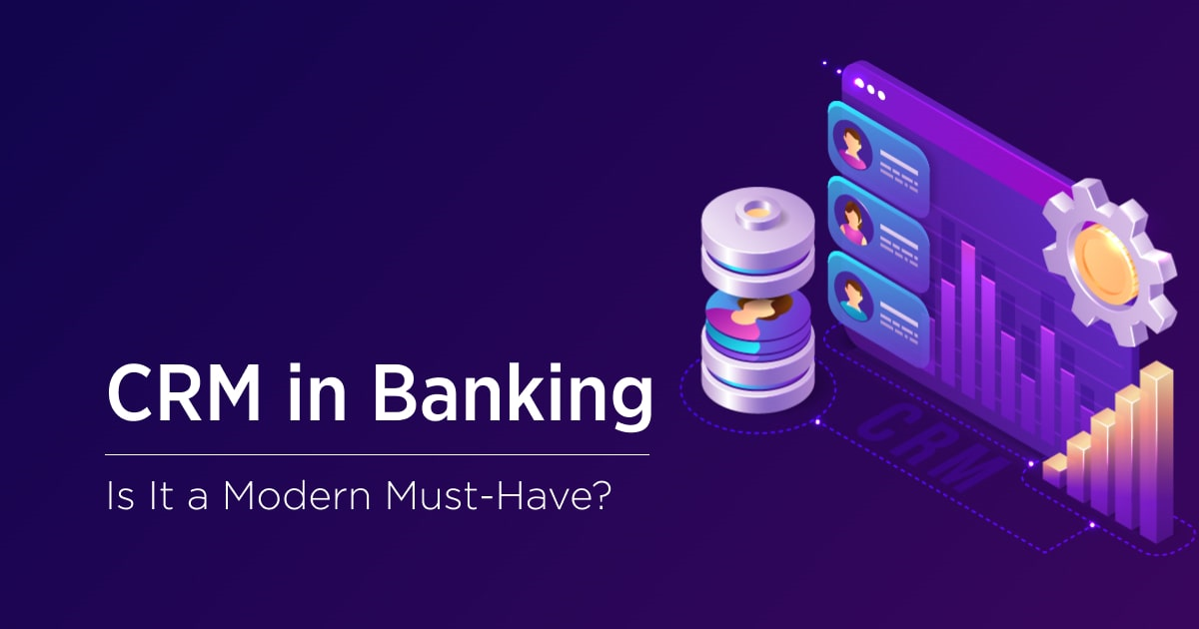
Let’s Dive into it !
Bank’s data of Customer Relations is quite complex and vast.
My Excel sheet Bank_CRM & PowerBI sheet unveils data of customers, their behaviors & relationship with bank and trends discussed in this presentation.

Slide 6
Data Consolidation & Preprocessing
Fixed inconsistent values Corrected format in Excel of Joining Date (BOJ) in ‘YYYY-MM-DD’ format that SQL recognizes
Checked missing/error values Checked the Errors & Null values through Quality Columns in the View Tab, using Transform Data in PowerBI
Generated new data and measures In PowerBI, Generated new calculated column named Spending in Customer Info table and Credit Score Group & Churn Risk Score (CRS) in Bank Churn table.
Formatted Table & Model view Created data in table view and checked for Model view for any cardinality if needed.

Slide 7
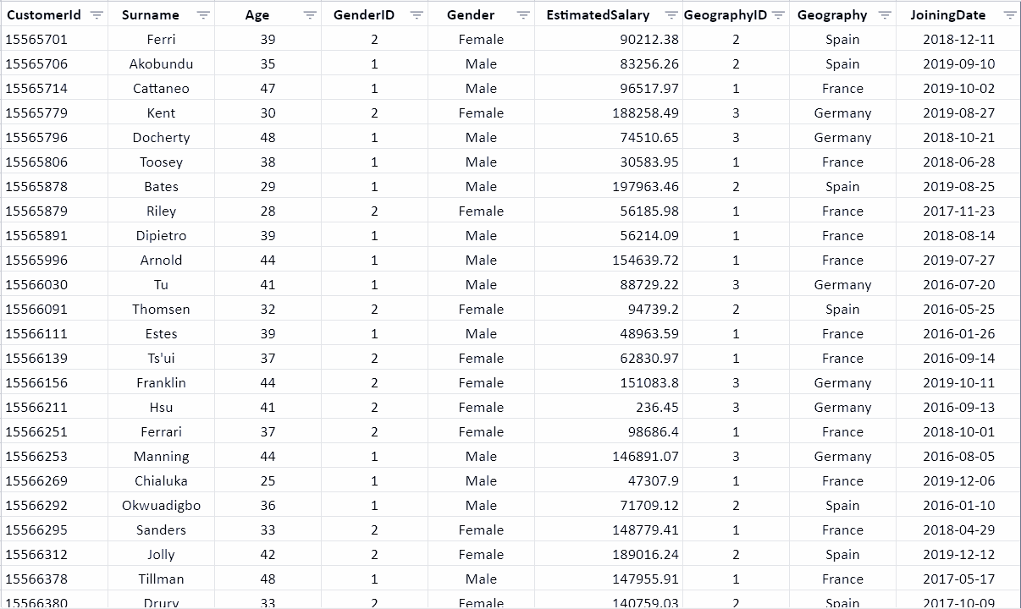
Customer Info Excel

Slide 8
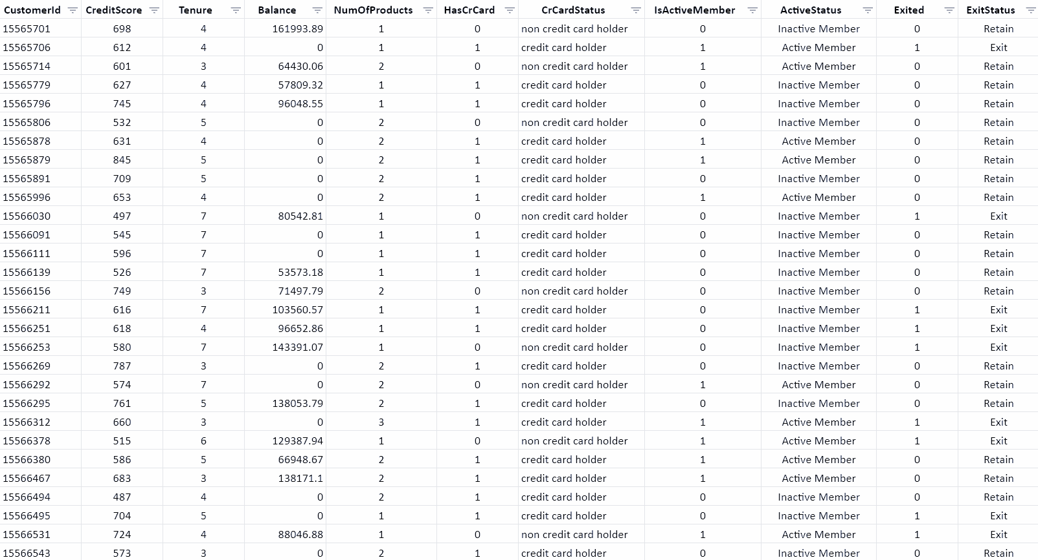
Bank churn Excel

Slide 9
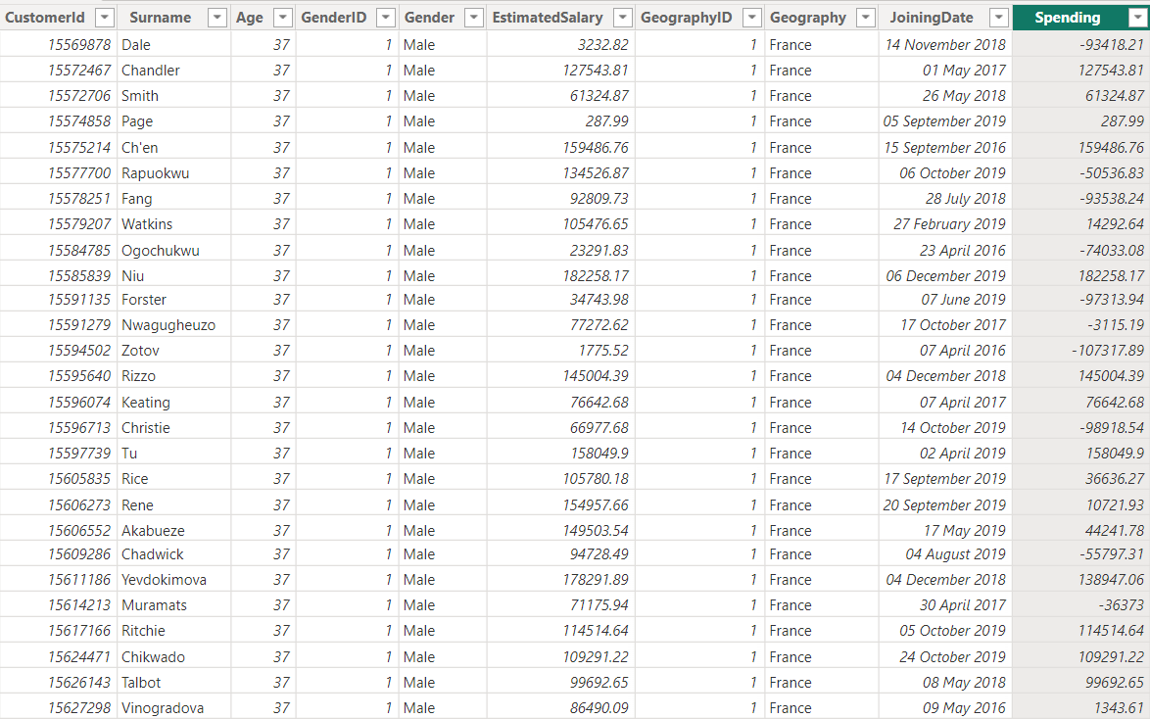
Customer Info Power BI

Slide 10
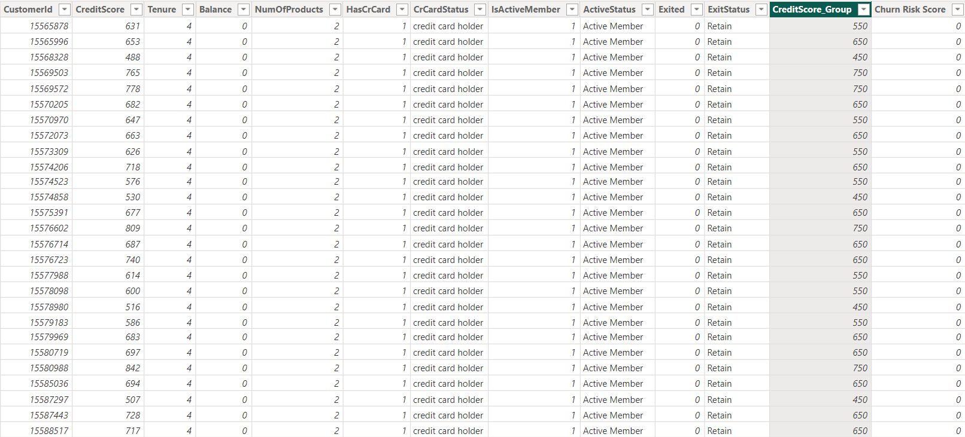
Bank Churn Power BI

Slide 11
Data storage and Manipulation
Imported Data into SQL Imported data from Excel into MySQL workbench and stored in database
Written Queries in Workbench Manipulated data by writing queries, extracting meaningful insights from it
SQL Concepts Used Basic & Advanced SQL concepts to solve objective questions

Slide 12
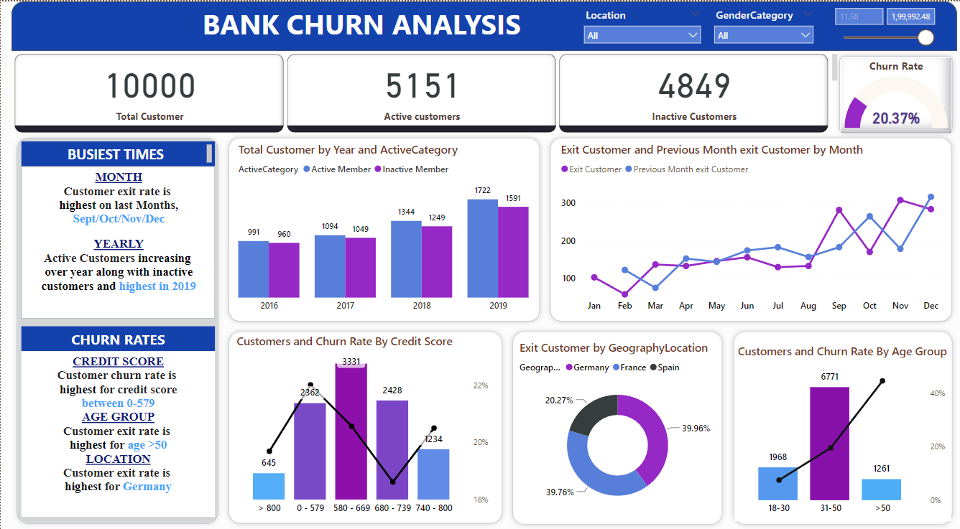

Slide 13
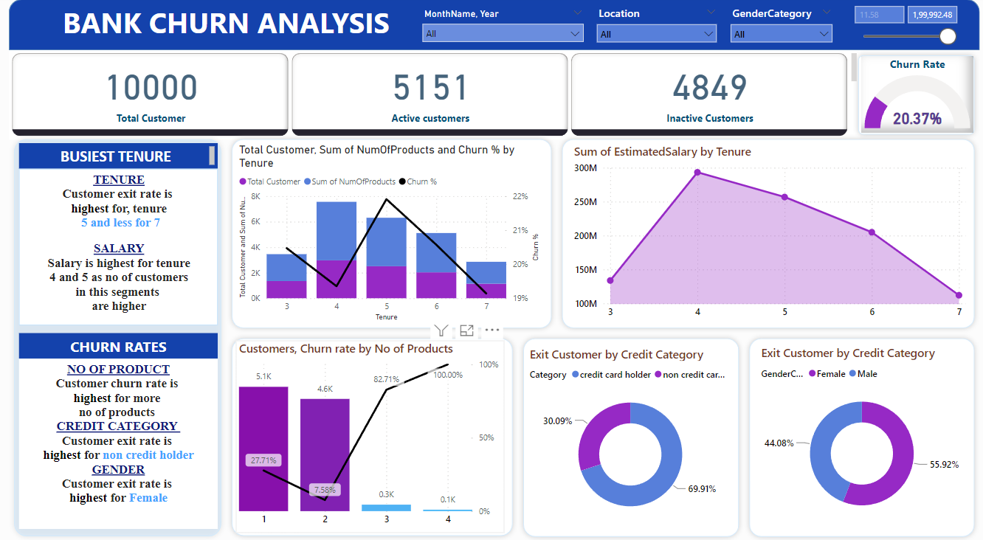

Slide 14
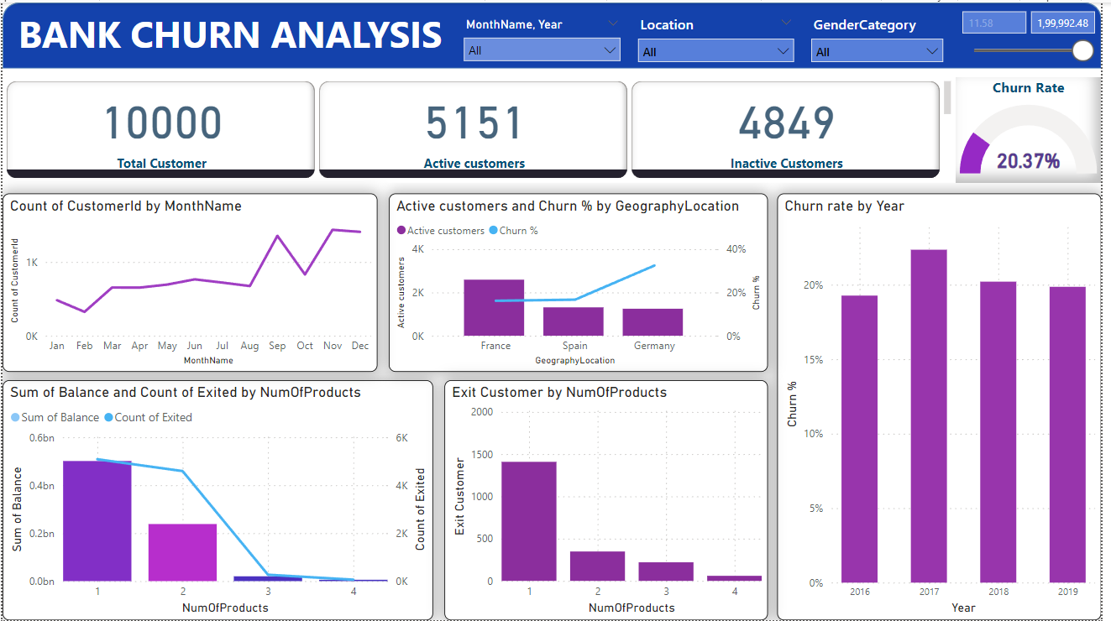

Slide 15

Statistical Insights
Total Customers: 10,000
Total Exited Customers: 2037
Total Active Customers: 5151
Average No. of Products (used by customers): 1.53
Average Tenure (of customers): 4.86 years
Average Balance (of customers): $ 76.5K
Average Churn Risk Score (CRS): 98.9 in range (0-500)

Slide 16

Key Insights
Germany appears to pose the highest financial risk to the bank, because of highest Churn rate (814) & least Active Members (1248)
France has most no. of Active Members (2591)
Spain has least no. of customers Churned (413)
No strong correlation with number of Active members and Average estimated salary.
Females (0.25) have higher churn rate than Males (0.16)
Poor segment of Credit Scores (300-579) has the highest exit rate
Having a Credit card doesn’t have a significant impact on churn rates
Most commonly used Number of Product is 1 for customers who have Exited the bank
Large number of customers join bank during months of Aug - Dec period
Individuals from 30-50 years of age most no. of Credit Cards

Slide 17
Factors Contributing to Bank Churn
When analyzing the reasons behind bank churn, several factors comes into play. Understanding these factors can help
Banks Identify areas for improvements and implement strategies to retain customers.
Factors | Description
Customer Satisfaction | Low levels of customer satisfaction can lead to churn. Dissatisfaction with customer Service, long wait times, and Unresolved issues are common reasons why customers churn banks.
Fees and Charges | High fees and charges can be a significant deterrent for customers. If a banks fees are higher compared to or if customers feel they are being charged unfairly, they may choose to switch banks.
Competition | Intense competition in the banking industry can lead to churn, If a competitor offers better rates, incentives, or a more user-friendly experience, customers may be tempted to switch banks.

Slide 18
Retention Strategies
Retention Strategies to Reduce Bank Churn
Strategy | Description
Personalized Offers | Provide tailored offers and incentives based on customer preferences and behavior to encourage retention.
Customers Loyalty Programs | Implement loyalty programs that reward customers for their continued business and encourage them to stay with the bank.
Improved Customer Service | Enhance the customer service experience service experiences by providing and personalized assistance, resolving issues efficiently, and addressing customer feedback.

Slide 19
Conclusion & Suggestions
Add more details in data of Bank CRM with for direct correlation between campaign exposure and assess changes in customer behavior.
Segmenting your data, conducting trend analysis, and utilizing control groups when possible, can help gain valuable insights
Region centric marketing should be considered to engage & retain customers from specific region (geography)
Simplify processes like account opening and online banking to enhance user experience and reduce churn caused by frustration.
Analyze customer behavior and offer targeted rewards – cashback for high spenders, financial consultations for low product users – to increase engagement
All Strategies must be formed to connect with customer at personalized level with integrity. These will optimise campaigns & drive long-term business growth

Slide 20
THANK YOU!
NEWTON SCHOOL

